Slide 1
TAS view on Constellations
8 october 2020
Didier Le Boulch
VP Telecom strategy & solutions
didier.le-boulch@thalesaleniaspace.com

Slide 2
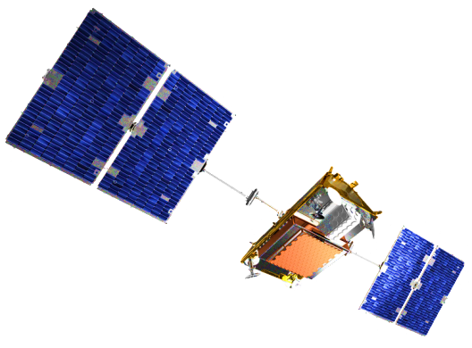
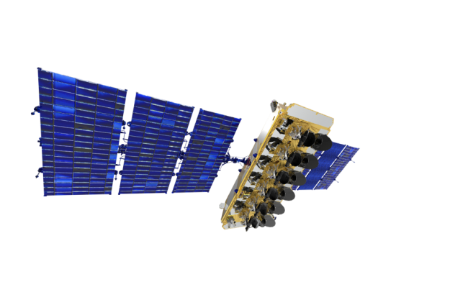
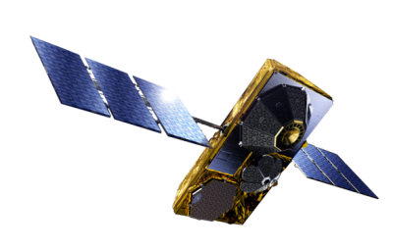
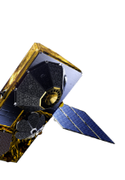
TAS: Supplier of the 3 operational telecom constellations
Iridium® NEXT
O3b Networks
Globalstar 2
Globalstar 1
Future trend ?

Slide 3
Will the LEO’s replace the GEO’s ?
LEOs pros
Global coverage
Latency
Smaller cells
Higher frequency reuse
Favorable environment
Cheaper Injection
International DNA
GEOs pros
Lower CAPEX
Scalable deployment
Capacity to focus
Broadcast / multicast
Low cost FSS terminals
Quicker ISD
national-regional /DNA
very different usages

Slide 4
A LEO constellation …What for ?
Pros Cons What for ?
IOT
not expensive very low revenues many projects
World wide coverage
Mobile Service
Smartphone
Direct Access
NTN Fills the gaps need spectrum
user ground segment is there high CAPEX The next big Thing ?
5G is coming new ecosystem
Backhauling
Internet Access
Broadband
balanced capacity spectral room
Low latency tracking terminals for few projects very high CAPEX very competitive

Slide 5
THANK YOU

